Slide 1
IS216 Web Application Development II
Week 4
JavaScript – Part 1 (Basics)
DIY e-Learning
K. J. Shim
Sections: G3/G4
https://tinyurl.com/is216-krazy-2024-js-part1

Slide 2

Source Code Files
eLearn → Content → Week 4 (DIY e-Learning) → Week4-DIY.zip
Unzip it into your webroot (any meaningful sub-directory), for example:
(WAMP) C:\wamp64\www\is216\...\Week4-DIY
(MAMP) /Applications/MAMP/htdocs/is216/…/Week4-DIY
Visit web pages (.html) via HTTP protocol
Do NOT double-click on the HTML file. Your computer will open the HTML file as a file.
→ OH NO…
Open web pages via HTTP protocol. How? Go to the web browser’s address bar
→ GOOD

Slide 3
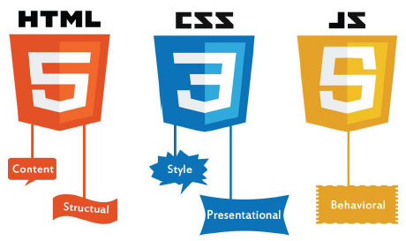


Topics
Syntax
Data types
Operators
Conditional statements
Loops
Functions
String operations
Array operations

Slide 4
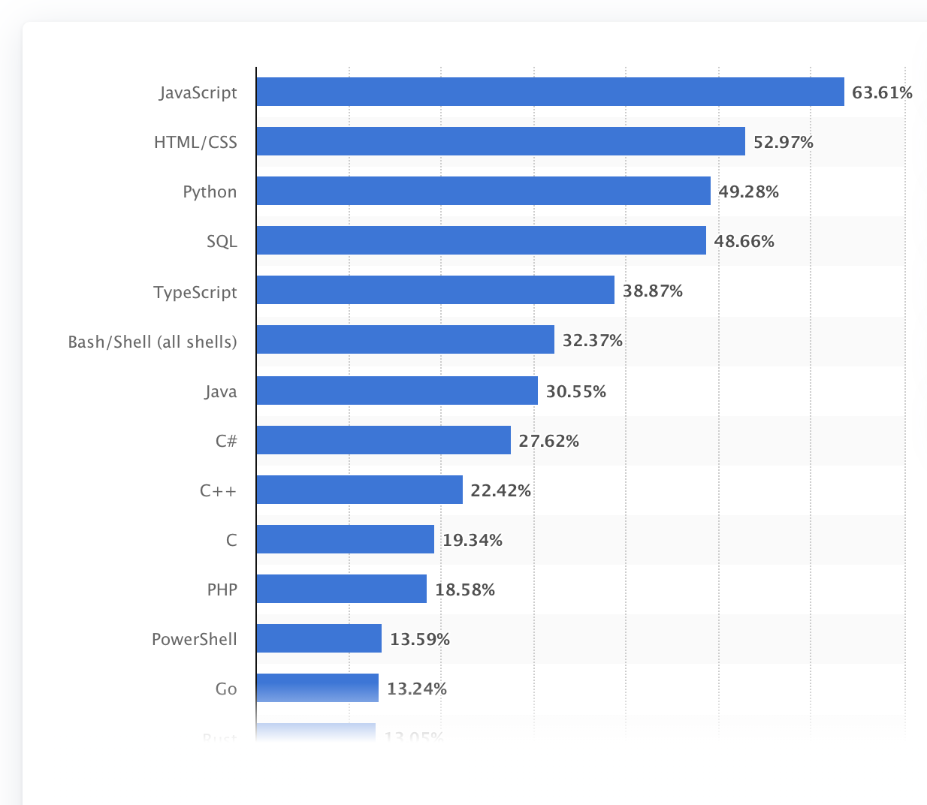
JavaScript
High-level
Dynamic typing
(Prototype-based) Object-oriented
Functional
One of the three core technologies for Web applications.
Statista report 2023

Slide 5
JavaScript: Hello World
Note
type="text/javascript" is optional
Semicolon at the end of a statement is optional (but recommended) if there is only one statement at the line.
The “document” object represents the HTML document that is displayed in that window.
Example
<html>
<head>
<title>Hello World</title>
</head>
<body>
<script type="text/javascript">
document.write("Hello World!")
</script>
</body>
</html>
You can program with either VSC+Chrome or JSFiddle.net

Slide 6
JavaScript in <head> and <body>
JavaScript code can be placed in both HTML <head> and <body> sections.
Ideally, place JavaSscript code in <head> section, only if it needs to be executed before the page is rendered.
Most of the time, put it at the bottom of <body>.
Examples
<html>
<head>
<script>…</script>
</head>
<body>
<script>…</script>
</body>
</html>

Slide 7
JavaScript : Syntax
Declaration and assignment
// How to declare variables
var x, y, z;
const PI = 3.14159265359;
// How to assign values
x = 1; y = 2;
// How to compute values
z = x + y;
Commenting
// this is a single line comment
/*
The following function has the following specification.
Precondition: …
Postcondition: ...
*/

Slide 8
JavaScript: Keywords
var | Declares a variable
const | Declares a variable (cannot be reassigned)
if … else | Branches depending on some condition
for | Loop for some number of times
do … while | Loops while some condition is satisfied
continue | Jumps out of a loop and starts at the top
break | Terminates the containing loop
function | Declares a function
return | Exits a function
try … catch ... | Tries something and catch/handle exceptions
Case sensitive
Notes:
const has block scope

Slide 9
Naming Convention
Underscore: e.g.
first_name, last_name, master_card, inter_city
Upper Camel Case (Pascal Case): e.g.
FirstName, LastName, MasterCard, InterCity
Lower Camel Case: e.g.
firstName, lastName, masterCard, interCity

Slide 10
Data Types
JavaScript is dynamically typed.
Types of variables are generally not known at compile time
Type checks are performed mostly at run time.
Examples
var boo = 1 > 0; // Boolean, boo == true
var length = 16; // Number
var firstName = "Johnson"; // String
var schools = ["scis", "soa", "sol"]; // Array
var x = {name:"John", age:21}; // Object
var y; // typeof y == "undefined"

Slide 11
Numbers
JavaScript does not define different types of numbers.
JavaScript numbers are always stored as double precision floating point numbers.
Examples
// Written with decimals
var x1 = 34.00;
// Written without decimals
var x2 = 34;
//Scientific notations
var y = 123e5; // 12300000
var z = 123e-5; // 0.00123

Slide 12
Strings
String literals are written in quotes -- single or double quotes
There are many functions on strings.
Examples
//concatenation
"txt1" + 'txt2' //result: "txt1txt2"
//string length
"Txt1".length //result: 4
//create the string: Love all; "trust" a few
'Love all; "trust" a few'
//or through escaping
"Love all; \"trust\" a few"

Slide 13
Arrays
JavaScript arrays are written with square brackets [ ].
Array items are separated by commas.
Indexes start from zero, i.e., the first item is [0], second is [1], etc.
Example
var schools = ["SCIS", "SOA", "SOL"];
schools[1]; //result: SOA
var cars = new Array("Saab", "Volvo", "BMW");
var x = cars.length; // The length
var y = cars.sort(); // cars is sorted as well
Arrays are kinda objects.

Slide 14
Objects
JavaScript objects are written with curly brackets { }.
Object properties are written as name:value pairs, separated by commas.
Example
var person = {
firstName: "Yournal",
lastName: "Drunk",
age: 50
};
Objects are references.

Slide 15
Exercise 1
Given the following program,
var cars = [ "Saab", "Volvo", "BMW"];
var newcars = cars;
var person = { firstName: "Lance", lastName: "Foo", age: 30};
var newperson = person;
person.firstName = "Prince";
cars[0] = "Honda"
Take ex1.html, and complete the TODO and answer the following:
What is the value of newperson.firstName?
What is the value of newcars[0]?

Slide 16
Dynamic Typing
JavaScript is dynamically typed.
That is, the same variable can be of different data types at different times.
The type depends on the context.
Example:
var x; // x is undefined
x = 2; // Now x is a Number
x = "Britney"; // Now x is a String
Be mindful of the types.

Slide 17
Dynamic Typing
JavaScript converts the type of variables implicitly.
The idea is to infer automatically what is the expected type and convert the type implicitly.
Example:
var xx = "100";
var yy = "10";
var zz = xx / yy; // zz == 10
var z = xx - yy; // z == 90, likewise for multiply *
var zzz = xx + yy; // zzz will be "10010"

Slide 18
Type Conversion
It is your responsibility to make sure the types are correct, with facilities such as
Operator: typeof
Function: isNaN
Functions for type conversion
Example
typeof 3.14 // Returns "number"
typeof (3) // Returns "number"
typeof (3 + 4) // Returns "number”
typeof "" // Returns "string"
typeof "John" // Returns "string”
typeof false // Returns "boolean"
var x;
typeof x // Returns "undefined"

Slide 19
Type Conversion
It is your responsibility to make sure the types are correct, with facilities such as
Operator: typeOf
Function: isNaN
Functions for type conversion
NaN is a reserved word that represents a number that is not a legal number.
Example
var xx = 100 / "y"; // x will be NaN
isNaN(xx); // returns true
//how about 50 / "10"?
//how about typeOf NaN?

Slide 20
Type Conversion
Example
var x = 123;
x.toString();
(100+23).toString(); // returns “123”
var x = 9.656;
x.toFixed(2); // returns 9.66
Number("10.33"); // returns 10.33
Number("10,33"); // returns NaN
parseInt("10.33"); // returns 10
parseInt("10 years"); // returns 10
parseInt("years 10"); // returns NaN
parseFloat("10.33"); // returns 10.33
parseFloat("10 20 30"); // returns 10
It is your responsibility to make sure the types are correct, with facilities such as
Operator: typeOf
Function: isNaN
Functions for type conversion

Slide 21
Exercise 2
Make use of ex2.html to evaluate the following. Check whether the results are expected.
5 + "34"
5 - "4"
10 % 5
5 % 10
"Java" + "Script"
" " + " "
" " + 0
true + true
true + false
false + true
false - true
3 - 4
"Bob" - "bill"
// Evaluate the below comparisons:
5 >= 1
4 <= 1
1 != 1
"A" > "B"
"B" < "C"
"a" > "A"
"b" < "A"
true != true

Slide 22
Operators
+, -, *, **, /, % | Addition, Subtraction, Multiplication, Exponentiation, Dvision, Modulus,
++, -- | Increment and Decrement (by 1)
+=, -=, *=, /=, %=, **= | Example: x+=y //x = x+y; Example: x **= y //x = x**y
==, != | Check equality after type conversion
===, !== | Check if the type is the same and then if the value is the same
<, >, >=, <=, != | Usual meanings
? … : ... | Example: x>y?x:y
&&, ||, ! | Logical and, or, and negate

Slide 23
= vs. == vs. ===
Examples
0 == false // Result??
0 === false // Result??
2 == "2" // Result??
2 === "2" // Result??
10 = 10 // Result??
Notes:
true/false/true/false/error

Slide 24
Conditional Branching
Syntax
if (condition) {
//...
} else { //optional
//...
} else { //optional
//...
}
Examples
var age = prompt("What is your age?");
if( Number(age) < 18 ) {
alert("Sorry, you are too young to drive this car");
} else if( Number(age) > 18 ) {
alert("Enjoy the ride!");
} else if( Number(age) === 18 ) {
alert("Congratulations on your first year of driving.");
}

Slide 25
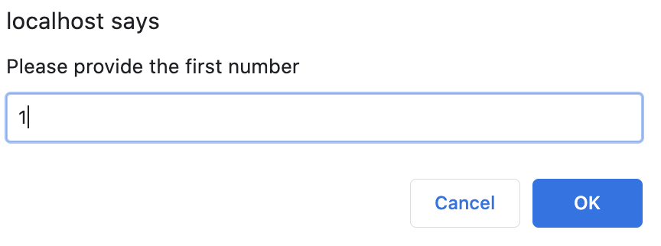
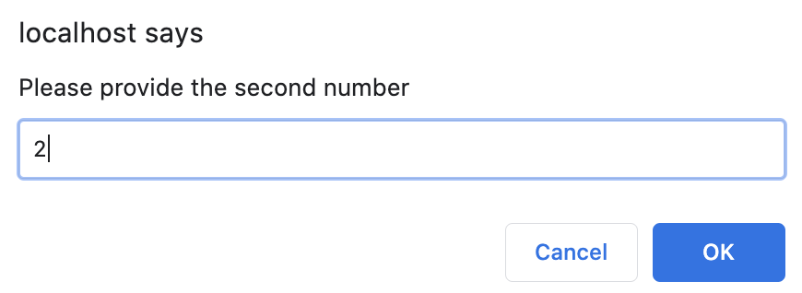
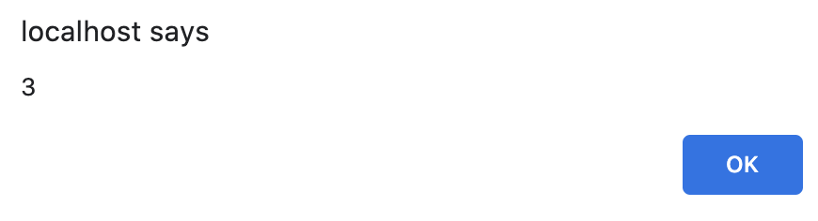
Exercise 3
Given ex3.html, implement a simple calculator based on the requirements.

Slide 26
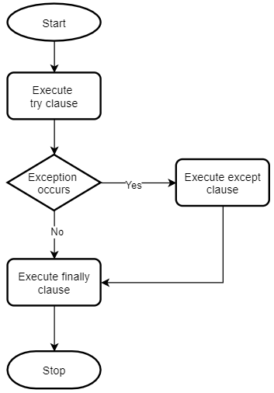
Exception Handling
Syntax
try {
// Block of code to try
}
catch(err) {
// Block of code to handle errors
}
finally {
/* Block of code to execute
regardless of try/catch result */
}

Slide 27
Exception Handling
Syntax
try {
...
}
catch(err) {
...
}
finally {
...
}
Example
var json = openAndReadFile();
try {
var user = JSON.parse(json); // error occurs
alert( user.name ); // doesn't work
}
catch (e) {
// ...the execution jumps here
alert( "Our apologies. Jnvalid JSON." );
}
finally {
closeFile();
}

Slide 28
Loops
for … in loops, loops through the properties of an object
Example:
var person = {
firstName: "Lance",
lastName: "Kaypoh", school: "SCIS"
age: 25 };
var prop;
for (prop in person) {
console.log(person[prop]);
}
//result: Lance, Kaypoh, SCIS, 25
for-loops, loops through a block of code for a number of times
Example:
for( i=0; I < 10; i++ ) {
console.log(i);
}

Slide 29
Loops
for … of loops, loop through the values of an iterable variable
Example:
var sharks = [ "great white", "tiger"];
for( shark of sharks ) {
console.log(shark);
}
for( c of "sfdagdsg@da") {
if (c == "@") {
found = true;
}
}
while–loops through a block of code until a specified condition becomes false
Example:
while (i < 10) { text += "<br>The number is " + i; i++; }
for … of … doesn’t work for objects.
for … in … works for arrays.

Slide 30
Exercise 4
Complete ex4.html.
Given an array, loop through the array and then find the person called “The Chosen One”. Print his name and age in the console.

Slide 31
String Operations
Operation | Remark | Example
length | Returns the length of the string | var txt = "ABCDEFGHIJKLMNOPQRSTUVWXYZ"; txt.length //result: 26
indexOf | Returns the index of the given string; -1 if it is non-existent | //string indexing "Please locate where 'locate' occurs!".indexOf("locate"); //result: 7
lastIndexOf | Returns the index of the last occurrence of a specified text in a string | txt.lastIndexOf(“EFG”) //4 txt.lastIndexOf(“EFG”, 5) //-1 (not exist); searching backwards from index 5
slice | Extracts a part of a string and returns the extracted part in a new string | var str = "Apple, Banana, Kiwi"; var res = str.slice(7,13); //result: Banana str.slice(1) //”pple, Banana, Kiwi”
Notes:
Slice: second parameter is optional - with a default value of the length of the string

Slide 32
String Operations
Operation | Remark | Example
toLowerCase | ... | var txt2 = txt.toLowerCase();
toUpperCase | ... | txt = txt2.toUpperCase();
trim | Removes whitespace from both sides of a string | var str = " Hello World! "; alert(str.trim()); // “Hello World!”
substring | Extracts a part of a string and returns the extracted part in a new string | var schools = "SOA, SIS, SOL"; var sis = schools.substr(5, 3); // SIS schools.substr(5); // SIS, SOL
Notes:
Refer to slide-22 for d-block

Slide 33
String Operations
Operation | Remark | Example
replace | Searches a string for a specified value, or a regular expression, and returns a new string where the specified values are replaced; By default, the replace() method replaces only the first match | var str1 = "IS216 is an awesome IS course!"; var str2 = str1.replace("IS216", "CS216");
split | Convert a string into an array | var str = "a,b,c,d,e"; // String var arr = str.split(","); // Split on commas console.log(arr); var str = "Hello"; // String var arr2 = str.split(""); // Split in characters

Slide 34
Array Operations
Operation | Remark | Example
push | Adds a new element at the end | var schools = ["SIS", "SOA", "SOL"]; schools.push("SOSS");
pop | Removes the last element | schools.pop(); // Removes the last element "SOSS"
shift | Pops the first element | var schools = ["SIS", "SOA", "SOL"]; var sis = schools.shift(); // sis = “SIS”
unshift | Adds a new element at index 0. | // “SOSS” is added at idx 0. returns 3 schools.unshift(“SOSS”);
slice | Creates a slice of an array | var schools = ["SOSS","SIS","SOE","SOL"]; var newSchools = schools.slice(1,3); // -> SIS,SOE var newSchools = schools.slice(2); // -> SOE,SOL

Slide 35
Looping Over Array Elements
for-loops can be used to loop through an array:
Try using for … of loop
Examples
var schools, schoolList, len, i;
schools = ["SOSS", "SCIS", "SOE", "SOL"];
len = schools.length;
schoolList = "<ul>";
for( i = 0; i < len; i++ ) {
schoolList += "<li>" + schools[i] + "</li>";
}
schoolList += "</ul>";

Slide 36
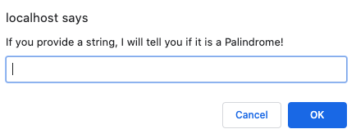
Exercise 5
Given ex5.html, complete the following task: check whether the the user-provided string is a palindrome or not.
***A palindrome is a string which reads the same backward as forward. For example, “Race Car” and “Anna” are palindromes. “Apple Pie” and “John” are not. Ignore spaces in deciding a palindrome.

Slide 37
Functions
A block of code designed to perform a particular task.
A function is executed when "something" invokes it.
A function has its own scope.
Example
function toCelsius(fahrenheit) {
return (5/9) * (fahrenheit-32);
}
var temp = "The temperature is " + toCelsius(75) + " Celsius";
function myFunction() {
var school = "SCIS";
// code here CAN use var school
}
// code here can NOT use var school

Slide 38
Functions
JavaScript is “functional”.
Functions are objects.
Examples
function toCelsius(fahrenheit) {
return (5/9) * (fahrenheit-32);
}
alert(typeof toCelsius); // function
alert(toCelsius instanceof Object); //true
var body = "return Math.PI * radius * radius";
var circle = new Function("radius", body);
alert(circle(5)); // 78.5398..

Slide 39
Functions
JavaScript is “functional”.
Functions are objects.
Function objects can be passed around just like any object.
Examples:
// the following is a function which negates // any given function
function negate (f) {
return function (i) {
return !f(i);
};
}
var isNumber = negate(isNaN);
alert(isNumber(5)); // => true
alert(isNumber("A")); // => false
alert(isNumber(NaN)); // => false

Slide 40
Functions
Having functions as first-class citizen has a lot of convenience, e.g., callback functions.
Examples
const showMessage = function() {
console.log("This message is shown after 3 seconds");
}
setTimeout(showMessage, 3000);
// setTimeout is a function which calls a function after a // given period of time (in milliseconds).
setTimeout(function() {
console.log("This message is shown after 3 seconds");
}, 3000);

Slide 41
Functions and this
“this” keyword refers to the object it belongs to.
In a method, this refers to the owner object.
Alone, this refers to the global object.
In an event, this refers to the element that received the event.
Examples: wk4example2.html
function Book (type, author) {
this.type = type;
this.author = author;
this.getDetails = function () {
return this.type + " written by " + this.author;
}
}
var book = new Book("Fiction", "Peter King");
alert(book.getDetails());
// result: "Fiction written by Peter King"
alert(book.type) //what is the result

Slide 42
“this”
“this” refers to the current containing object.
Example
function bike() { console.log(this.name);
}
var name = "Ninja";
var obj1 = { name: "Pulsar", bike: bike };
var obj2 = { name: "Gixxer", bike: bike };
bike(); // what is logged?
obj1.bike(); // what is logged?
obj2.bike(); // what is logged?
Notes:
bike(); // "Ninja"
obj1.bike(); // "Pulsar"
obj2.bike(); // "Gixxer"

Slide 43
Callback Functions
Certain methods such as sort, find, and filter can invoke another function and pass parameters for processing (defined by the user), when they are invoked
Note that the function takes 3 arguments:
each array value, index of each value, array itself
When a callback function uses only the value parameter, the index and array parameters can be omitted
Example: filter
var numbers = [45, 4, 9, 16, 25]; var over18 = numbers.filter(myFunc); function myFunc(value, index, array) { return value > 18; }
return [45, 25]
Notes:
return value > 18 is checked for every element in the array

Slide 44
Callback Functions
Certain methods such as sort, find, and filter can invoke another function and pass parameters for processing (defined by the user), when they are invoked
Example: find (the first element that satisfies the given criteria)
var numbers = [4, 9, 16, 25, 29]; var first = numbers.find(myFunc); function myFunc(value, index, array) { return value > 18; }
return 25

Slide 45
Callback Functions
Certain methods such as sort, find, and filter can invoke another function and pass parameters for processing (defined by the user), when they are invoked
Example: forEach
var fruits = ["Orange", "Apple"]; var text = "<ul>"; fruits.forEach(myFunc); text += "</ul>"; function myFunc(value) { text += "<li>" + value + "</li>"; }
text = <ul><li>Orange</li><li>Apple</li></ul>

Slide 46
Prototype-based Object-Orientation
Objects in JavaScript are a collection of properties/methods.
Properties are written as name:value pairs.
Methods are actions that can be performed on objects.
Example: wk4example3.html
var user = {
name: "Mary",
age: 26,
hobby: ["swimming", "badminton"],
isMarried: false,
addHobby: function(new_hobby) {
this.hobby.push(new_hobby);
}
};
Be mindful of “this” in this example. Without it, there is an error.

Slide 47
Accessing Object Properties/Methods
You can access object properties and methods in two ways:
objectName.propertyName
objectName.method(parameters)
Or
objectName["propertyName"]
objectName["methodName"](parameters)
Example: wk4example3.html
console.log(user.name);
// access obj property like an array
console.log(user["name"]);
An array can be viewed as a special object of the following form
var array = {
0: "first", 1: "second", 2: "third"
};

Slide 48
Modifying Object Properties/Methods
You can modify object properties or methods in two ways:
objectName.propertyName = new_value;
Or,
objectName["propertyName"] = new_value;
You can add/delete object properties or methods.
Example
wk4example3.html

Slide 49
Exercise 6
forEach
forEach() method executes a provided function once for each array element.
Example
var array1 = [1, 2, 3];
array1.forEach( element => console.log(element+1)
);
// expected output: 2,3,4
Exercise
Given ex6.html, define a function which works in a way similar to forEach according to the provided requirements.

Slide 50
Take Away Message
JavaScript is
Dynamic typing
Prototype-based object-oriented
Functional

Slide 51
Questions? Need Help?
Join us in Slack
@
https://is216-oppa.slack.com
Thank You!

